Slide 1


Insulin in Type 2 Diabetes
September 12, 2026
INSULIN IN TYPE 2 DIABETES
_{Susie Jin RPh CDE} Saturday, September 12, 2026 Pharmacist, Certified Diabetes Educator 1:30pm – 3:00pm Volunteer, Diabetes Canada Clinical Practice Guidelines Steering Committee Editor-In-Chief, Diabetes Communicator Volunteer, Wounds Canada, Board of Directors
 | 2
PRESENTER DISCLOSURE □ I have the following relationships with commercial interests: Honorarium for educational program development and/or delivery: Abbott, Beiersdorf, Boehringer Ingelheim, Dexcom, Glaxo, Kenvue, Lilly, Sandoz, Sanofi Advisory Boards; Abbott, Lilly

Slide 2


Insulin in Type 2 Diabetes
September 12, 2026
 | 3
COMMERCIAL SUPPORT DISCLOSURE I have received a speaker’s fee from the Alberta Pharmacists’ Association for this learning activity This program has received no financial or in-kind support from any commercial or other organization
 | 4
BIAS MITIGATION I have done the following to mitigate potential bias: Program content was developed from nationally and internationally recognized Clinical Practice Guidelines, specifically: Diabetes Canada Clinical Practice Guidelines: available at guidelines.diabetes.ca Diabetes Canada Tools and Resources available at: guidelines.diabetes.ca diabetes.ca

Slide 3




Insulin in Type 2 Diabetes
September 12, 2026
5
INSULIN IN TYPE 2 DIABETES Place in Therapy
Susie Jin RPh CDE Pharmacist, Certified Diabetes Educator Volunteer, Diabetes Canada Clinical Practice Guidelines Steering Committee Editor-In-Chief, Diabetes Communicator Volunteer, Wounds Canada, Board of Directors
 | 6
TYPE 2 DIABETES IS A METABOLIC CONDITION Insulin resistance Insulin secretion Postprandial glucose Fasting glucose Microvascular complications Macrovascular complications Prediabetes Type 2 diabetes Metabolic Syndrome Schematic created by Susie Jin for illustrative purposes only. August 2026

Slide 4
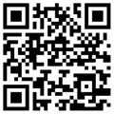

Insulin in Type 2 Diabetes
September 12, 2026
TYPE 2 DIABETES MANAGEMENT
healthy eating
activity
no smoking
7
Statin§ • GLP-1 RA +/- GIP RA
ACEi / ARB • SGLT2i
§ See Canadian Cardiovascular Society (CCS) Lipid Guidelines for other warranted therapies
Behaviour Cardiovascular
ASA, if ASCVD • nsMRA
<130 mmHg/80 mmHg
ACEi / ARB
thiazide / thiazide-like diuretic
long-acting dihydropyridine CCB
spironolactone
Interventions and Renal
metformin
⍺-glucosidase inhibitor
DPP4i
GLP-1 RA +/- GIP RA
insulin
secretagogue
SGLT2i
thiazolidinedione
<6.0 %
≤6.5 %
≤7.0 %
≤8.0 %*
≤8.5 %*
* If higher risk of unmanageable
hypoglycemia, A1C 7.1 % is the
recommended lower limit
Blood Pressure Target Maintenance
Protection
Glycemic Target Maintenance
statin
ezetimibe
PCSK9 inhibitor
icosapent ethyl (IPE)
bile acid sequestrant
fibrate
niacin
LDL-C ≤2.0 mmol/L, non-HDL-C ≤2.6 mmol/L or apo B ≤0.8 g/L
Lipid Target Maintenance
Immunizations Up-to-date
routine immunizations
workplace immunizations
travel immunizations
Screening for Complications
Eye (retinopathy): type 1 – annually; type 2 – every 1 to 2 y
Foot: monofilament/vibration yearly or more if abnormal
if ASCVD, LDL-C ≤1.8 mmol/L, non-HDL-C ≤2.4 mmol/L, apo B ≤0.7 g/L
Heart: ECG every 3 – 5 years if age >40 or diabetes complications
when TG <1.5 mmol/L: monitor with LDL-C, non-HDL-C or ApoB when TG ≥1.5 mmol/L: monitor with non-HDL-C or ApoB
Kidney: eGFR and ACR yearly, or more if abnormal
Liver: FIB-4 every 1 to 2 y
 | 8
LEARNING OBJECTIVES By the end of this presentation, participants will be able to: Find resources available on guidelines.diabetes.ca to support People starting insulin People managing type 2 diabetes with insulin to treat to the person’s individualized glycemic targets Apply these resources in a community pharmacy practice when Starting insulin Assessing existing insulin self-management in a person with type 2 diabetes

Slide 5
Insulin in Type 2 Diabetes
September 12, 2026
 | 9
INSULIN TOOLS AND RESOURCES GUIDELINES.DIABETES.CA DIABETES.CA
10
Insulin Resources
For People with Diabetes - Video
Insulin and You: A Guide to Injecting Insulin
FIND THESE RESOURCES
guidelines.diabetes.ca
For Health-care Providers
Starting Insulin: Individualizing/Choosing the insulin regimen & type
  Quick Reference Guide, Stepwise Approach to Insulin Regimens, panel 11
  Insulin Prescription Tool
  Insulin Pen Start Checklist
Treating to target:
  Quick Reference Guide
    Blood Glucose (BG) Targets for Glycemic Management
    Continuous Glucose Monitoring (CGM) Targets for Glycemic Management

Slide 6
Insulin in Type 2 Diabetes
September 12, 2026
11
Healthy Eating / Exercise Resources: For People with Diabetes
diabetes.ca
Mediterranean Diet and Diabetes
Protein and Diabetes
FIND THESE RESOURCES
guidelines.diabetes.ca
diabetes.ca
guidelines.diabetes.ca
Videos:
  Introduction to Resistance Exercise
  Resistance Band Workout
  Dumbbell Workout
  Additional Core Exercises
Physical Activity and Diabetes:
  Introductory Resistance Program
 | 12
LEARNING OBJECTIVES By the end of this presentation, participants will be able to: Find resources available on guidelines.diabetes.ca to support People starting insulin People managing type 2 diabetes with insulin to treat to the person’s individualized glycemic targets Apply these resources in a community pharmacy practice when Starting insulin Assessing existing insulin self-management in a person with type 2 diabetes

Slide 7
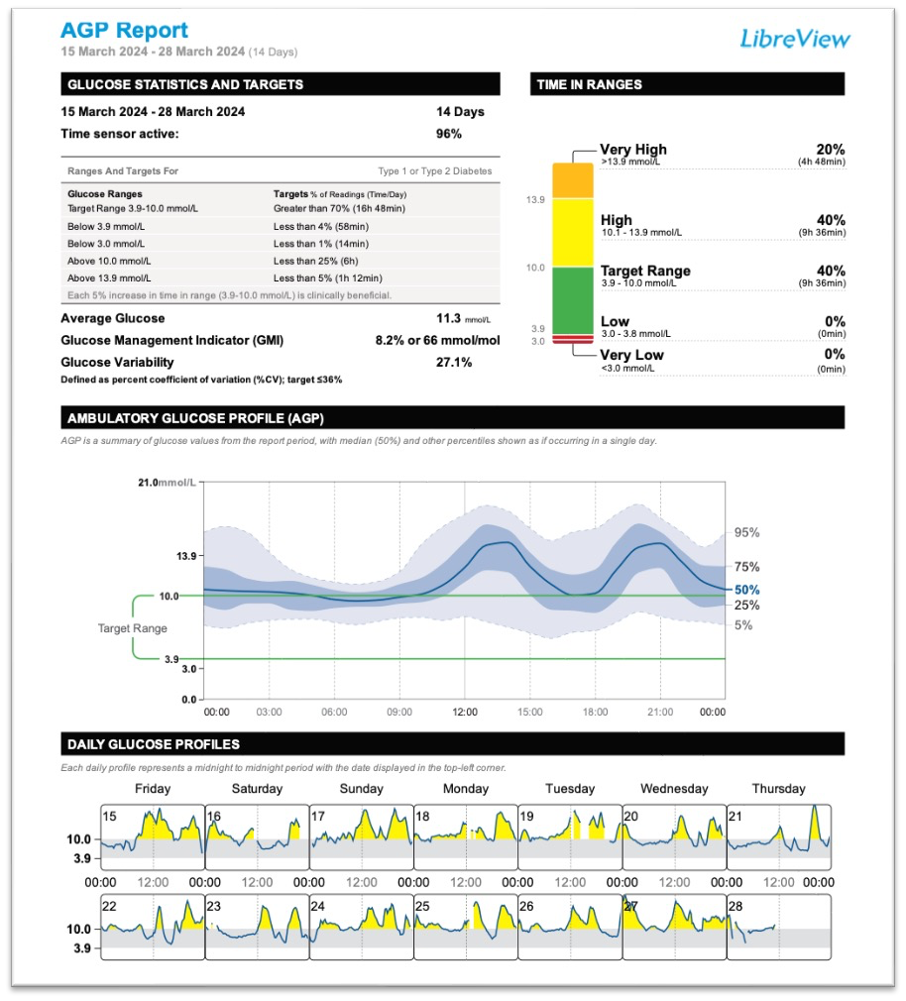

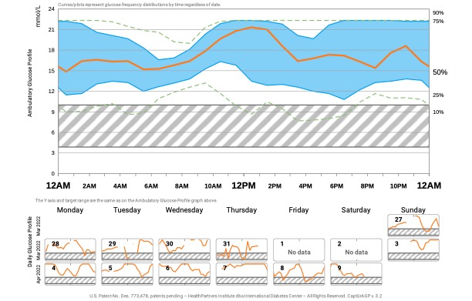
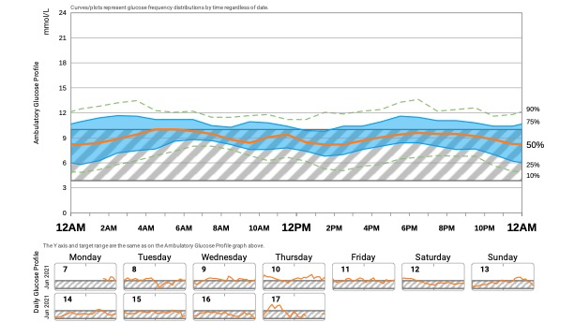
Insulin in Type 2 Diabetes
September 12, 2026
13
14
FLAT NARROW IN-RANGE

Slide 8

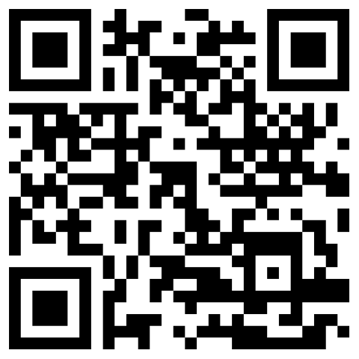
Insulin in Type 2 Diabetes
September 12, 2026
15
Carbohydrates/Stress hormones → sugar goes up
Insulin → sugar goes down
16
INSULIN PEN START CHECKLIST

Slide 9
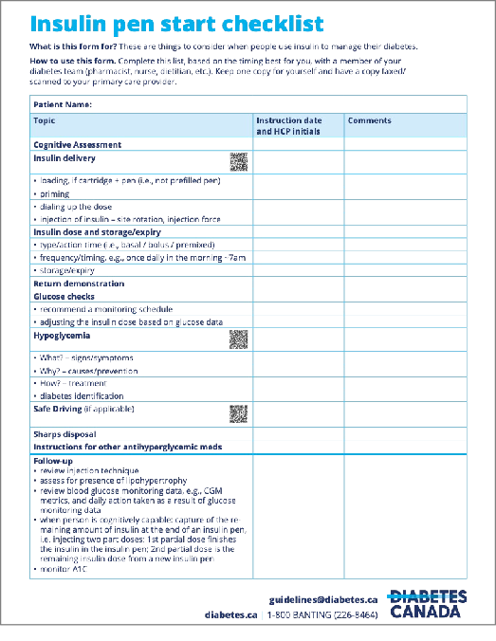

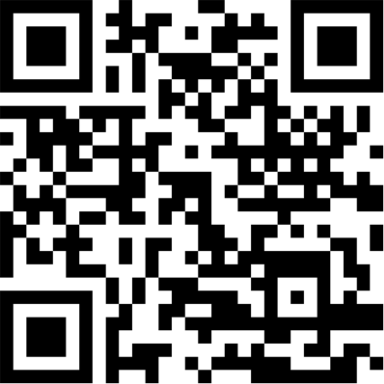
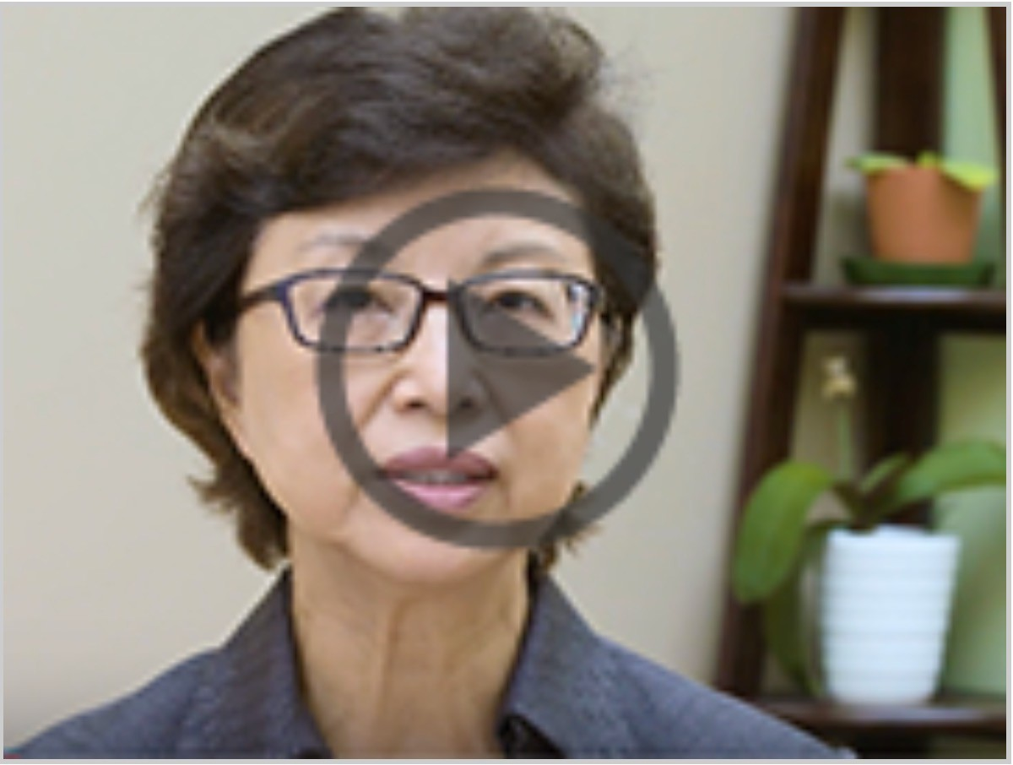
Insulin in Type 2 Diabetes
September 12, 2026
17
Starting insulin
Assessing insulin use
 | 18
DIABETES CANADA: VIDEO — INSULIN & YOU: A GUIDE TO INJECTING INSULIN

Slide 10
Insulin in Type 2 Diabetes
September 12, 2026
19
Starting insulin
Assessing insulin use
 | 20
STARTING INSULIN INDIVIDUALIZE / CHOOSE the Insulin Regimen and Type Insulin Regimens → Quick Reference Guide, panel 11 Insulin Type → Insulin Prescription

Slide 11

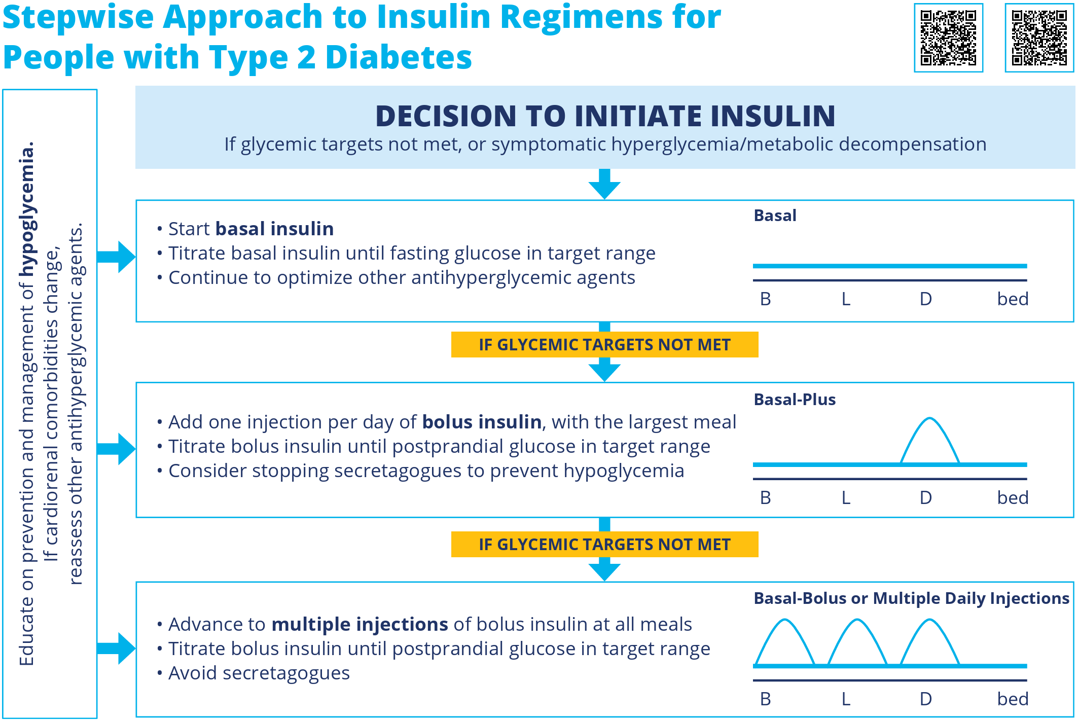
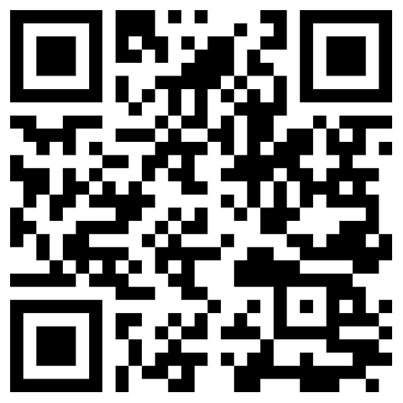
Insulin in Type 2 Diabetes
September 12, 2026
21
INSULIN REGIMENS
 | 22
INSULIN PRESCRIPTION INDIVIDUALIZING / CHOOSING THE INSULIN TYPE AND REGIMEN

Slide 12
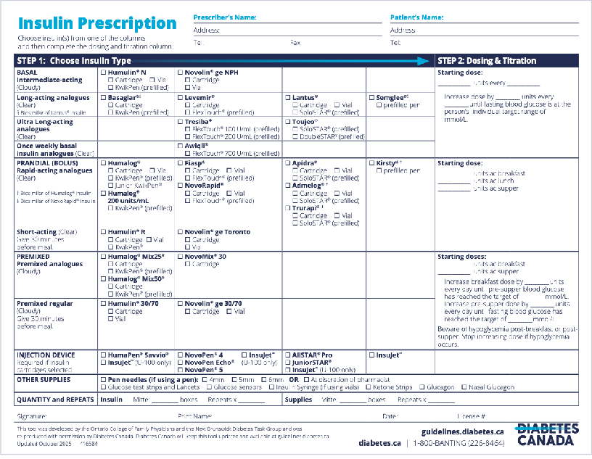

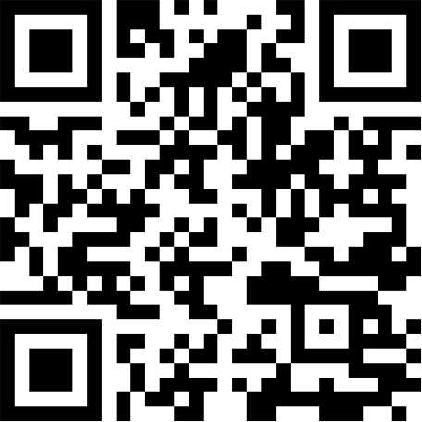
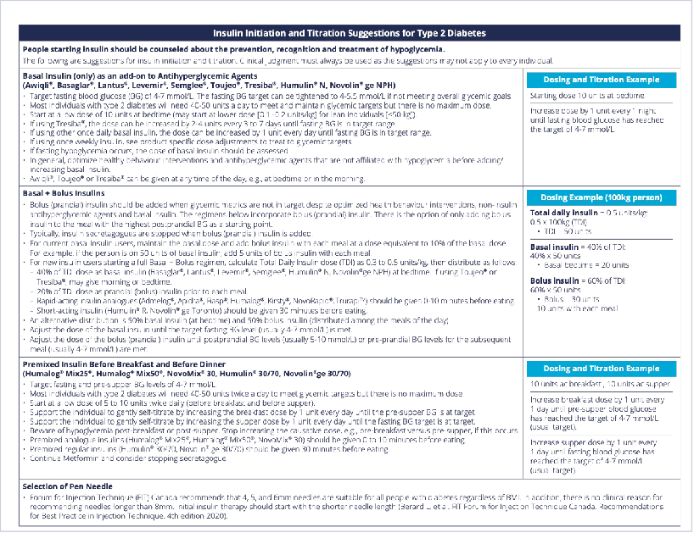
Insulin in Type 2 Diabetes
September 12, 2026
23
https://guidelines.diabetes.ca/GuideLines/media/Docs/Key%20Messages/Insulin_Prescription_EN_09_23.pdf
24
https://guidelines.diabetes.ca/GuideLines/media/Docs/Key%20Messages/Insulin_Prescription_EN_09_23.pdf

Slide 13
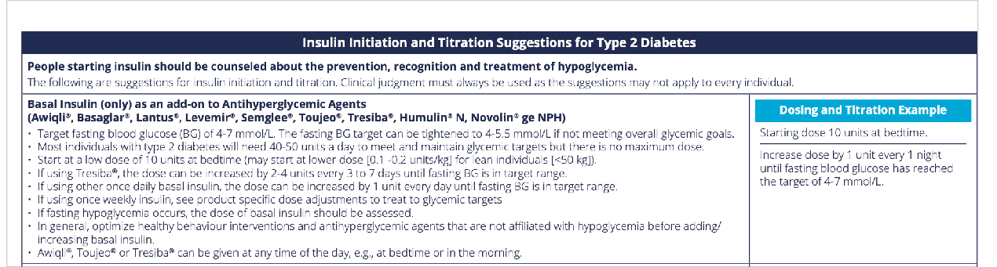


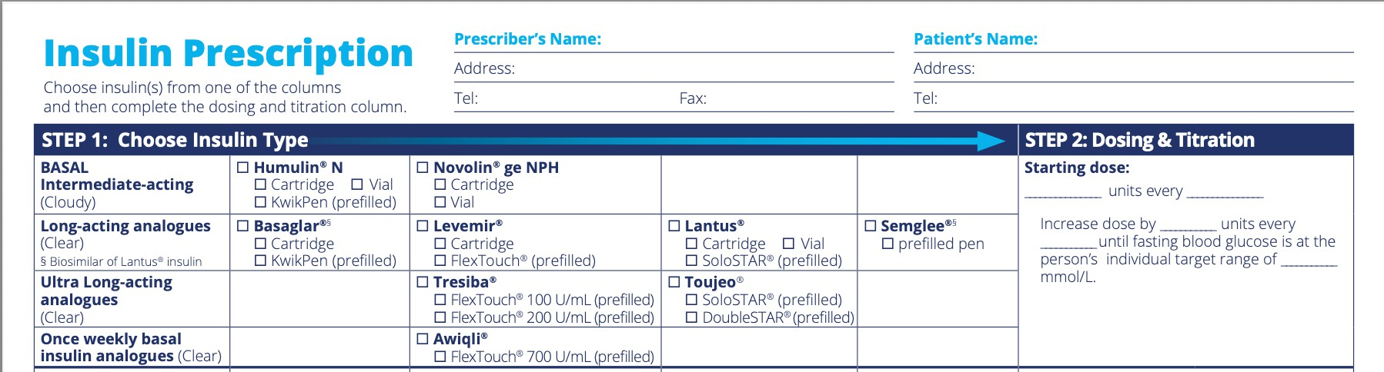
Insulin in Type 2 Diabetes
September 12, 2026
25
https://guidelines.diabetes.ca/GuideLines/media/Docs/Key%20Messages/Insulin_Prescription_EN_09_23.pdf
26
10
day
in the morning 1
4–7
https://guidelines.diabetes.ca/getmedia/04c4a238-6778-4a6c-80d6-50c61e6d9145/Insulin_Prescription_10_24.pdf

Slide 14



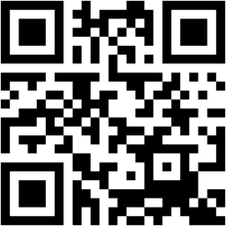
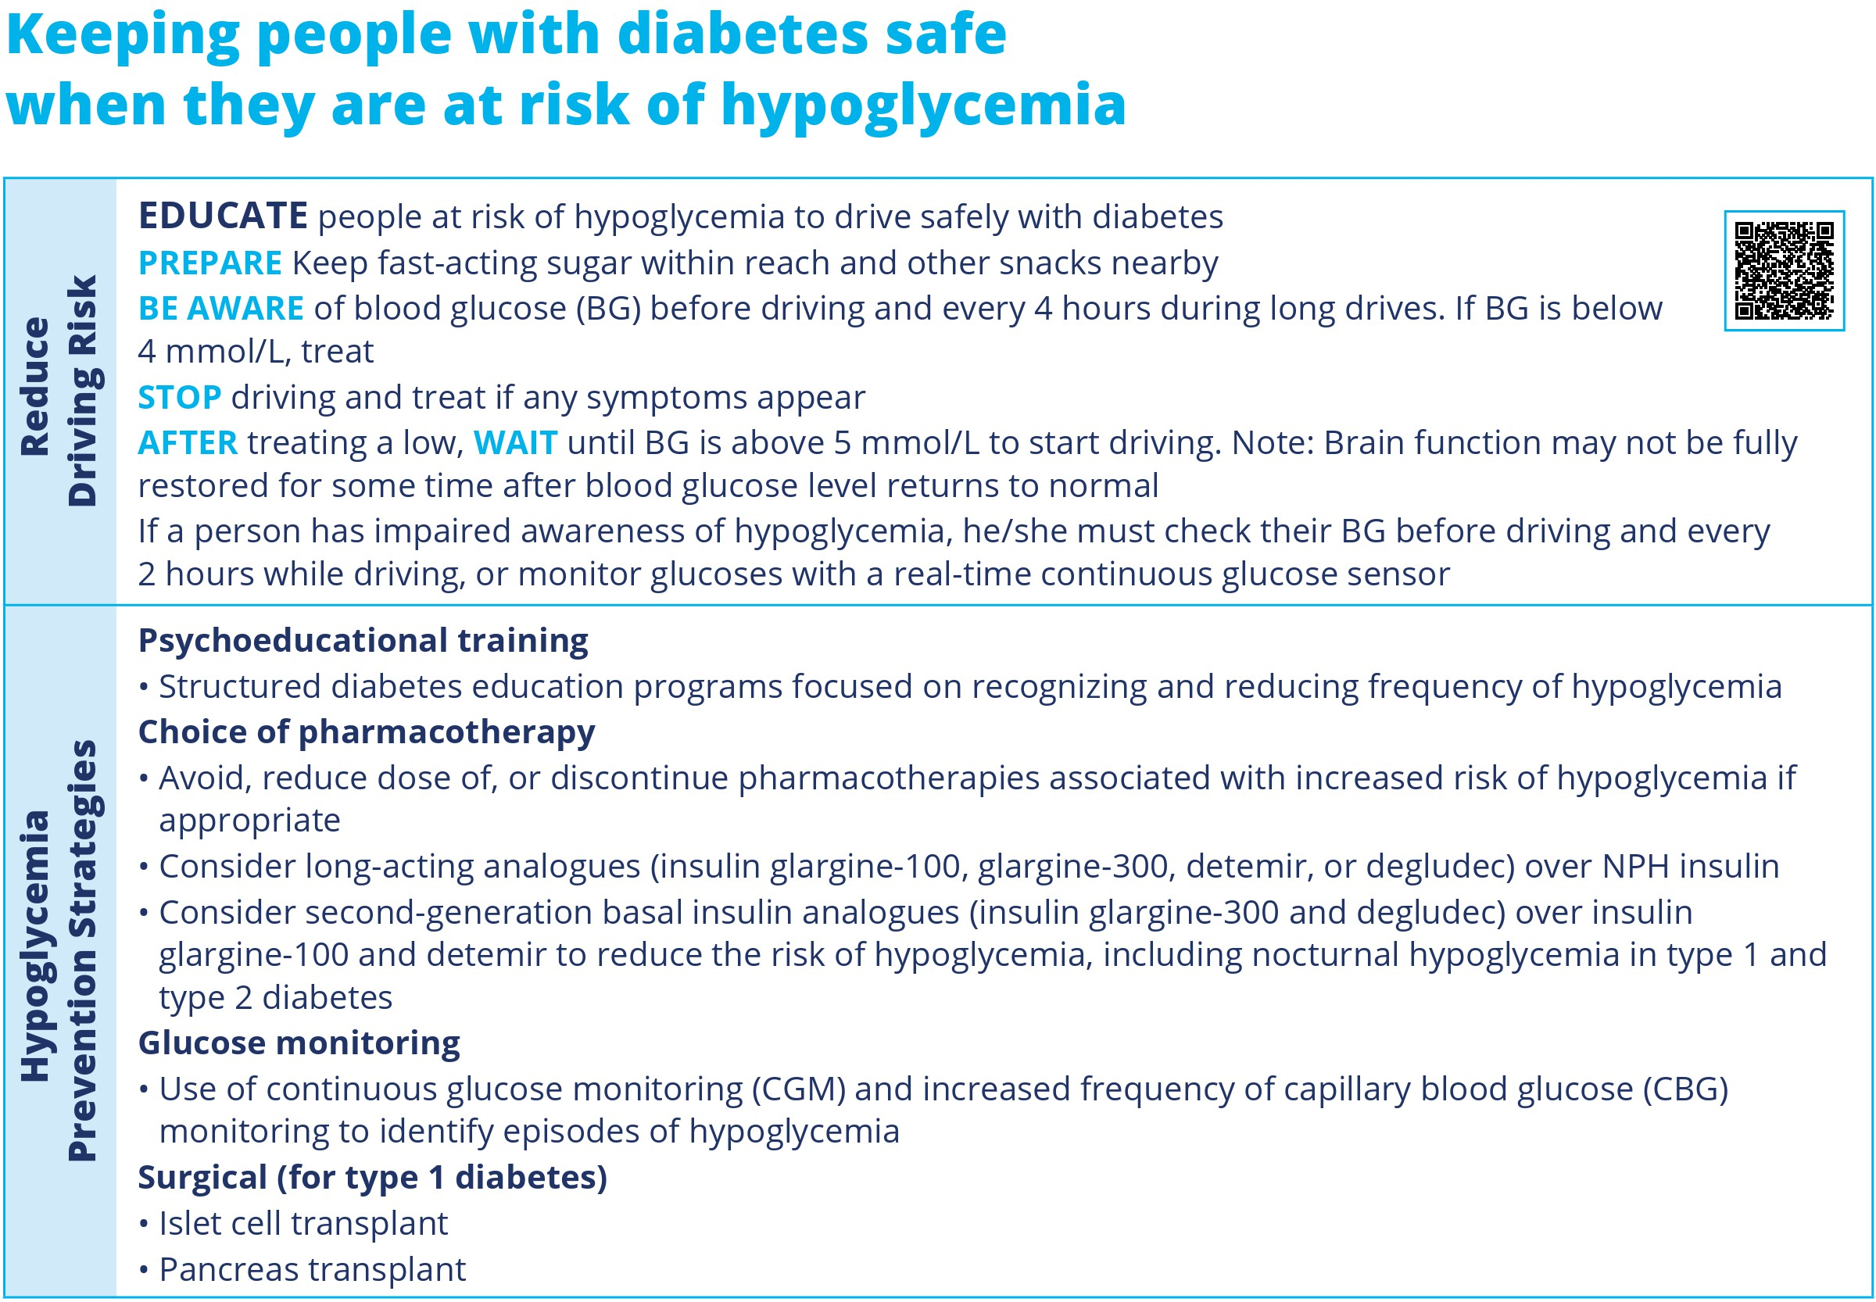
Insulin in Type 2 Diabetes
September 12, 2026
27
10
week
in the morning 2–4
4–7
70
week
once weekly 20
4–7
27

Slide 15

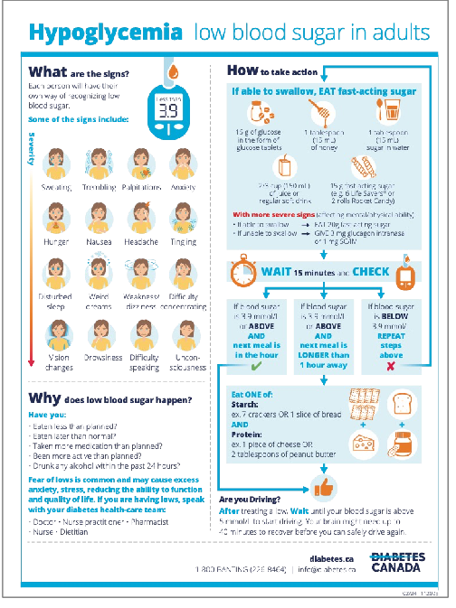

Insulin in Type 2 Diabetes
September 12, 2026
28
Starting insulin
Assessing insulin use
29

Slide 16


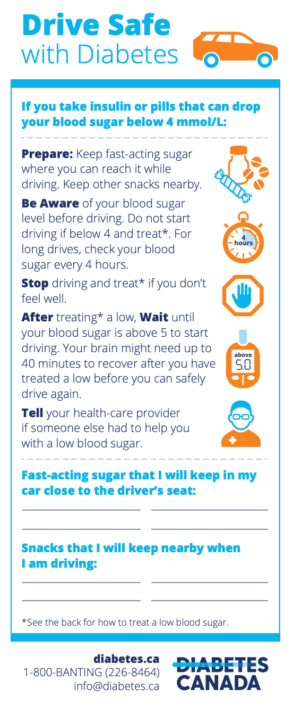
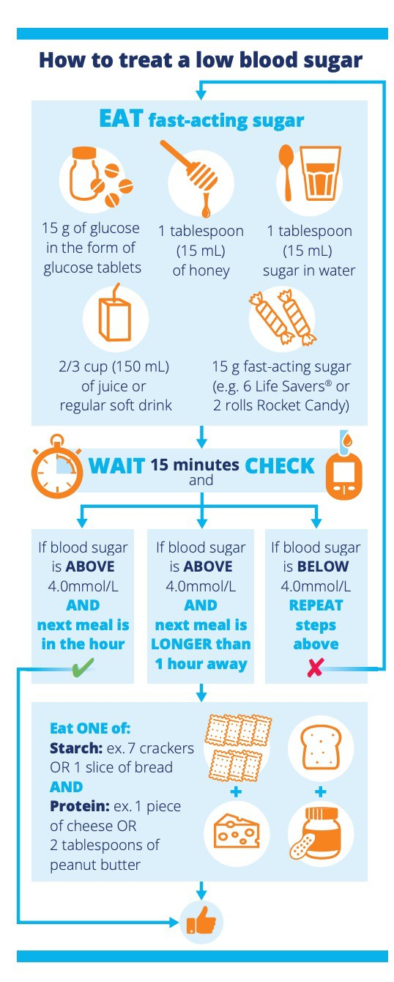
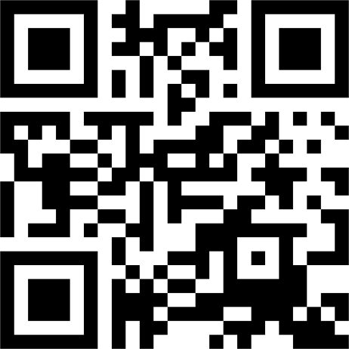
Insulin in Type 2 Diabetes
September 12, 2026
30
https://guidelines.diabetes.ca
/GuideLines/media/Docs/Pa tient%20Resources/drive-
safe-with-diabetes.pdf
31
Starting insulin
Assessing insulin use

Slide 17
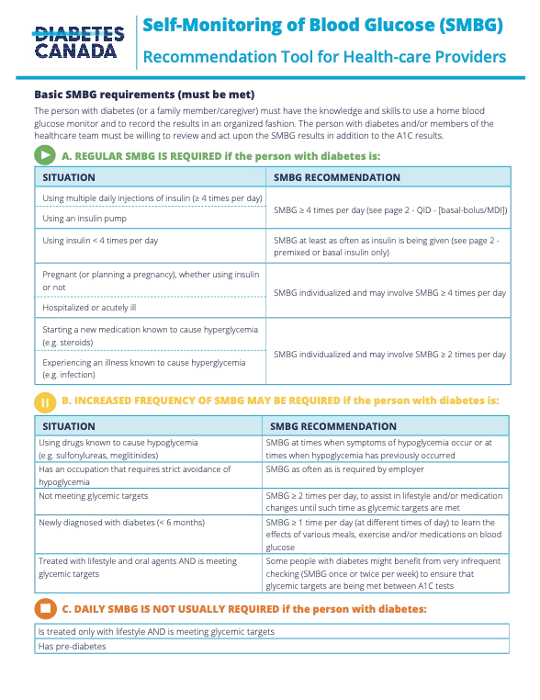
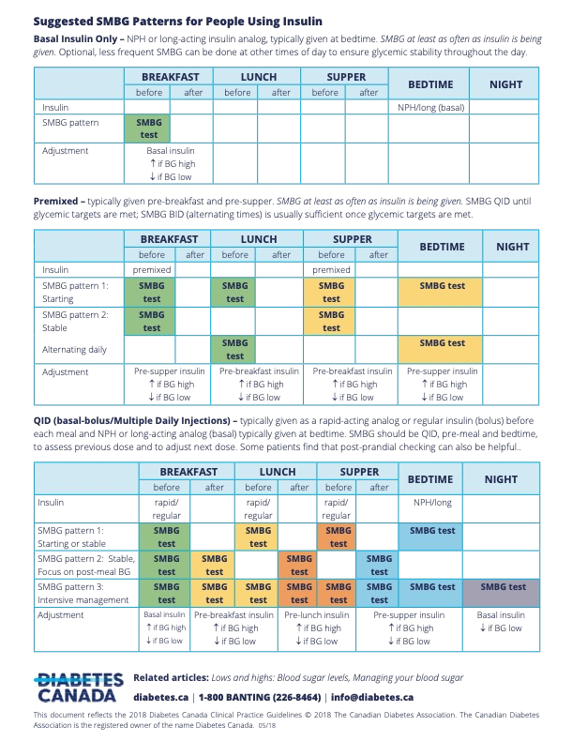
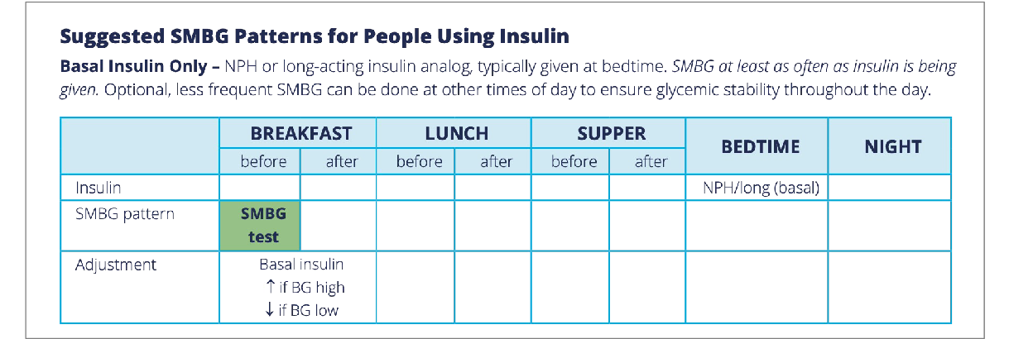

Insulin in Type 2 Diabetes
September 12, 2026
GLUCOSE CHECKS:
RECOMMEND A MONITORING SCHEDULE
ADJUSTING THE INSULIN DOSE BASED ON GLUCOSE DATA
32
https://guidelines.diabetes. ca/self-management/smbg-recommendation-sheet
 | 33
GLUCOSE CHECKS: RECOMMEND A MONITORING SCHEDULE ADJUSTING THE INSULIN DOSE BASED ON GLUCOSE DATA https://guidelines.diabetes.ca/self-management/smbg-recommendation-sheet

Slide 18
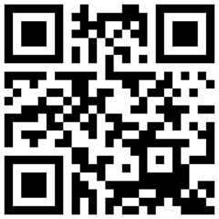
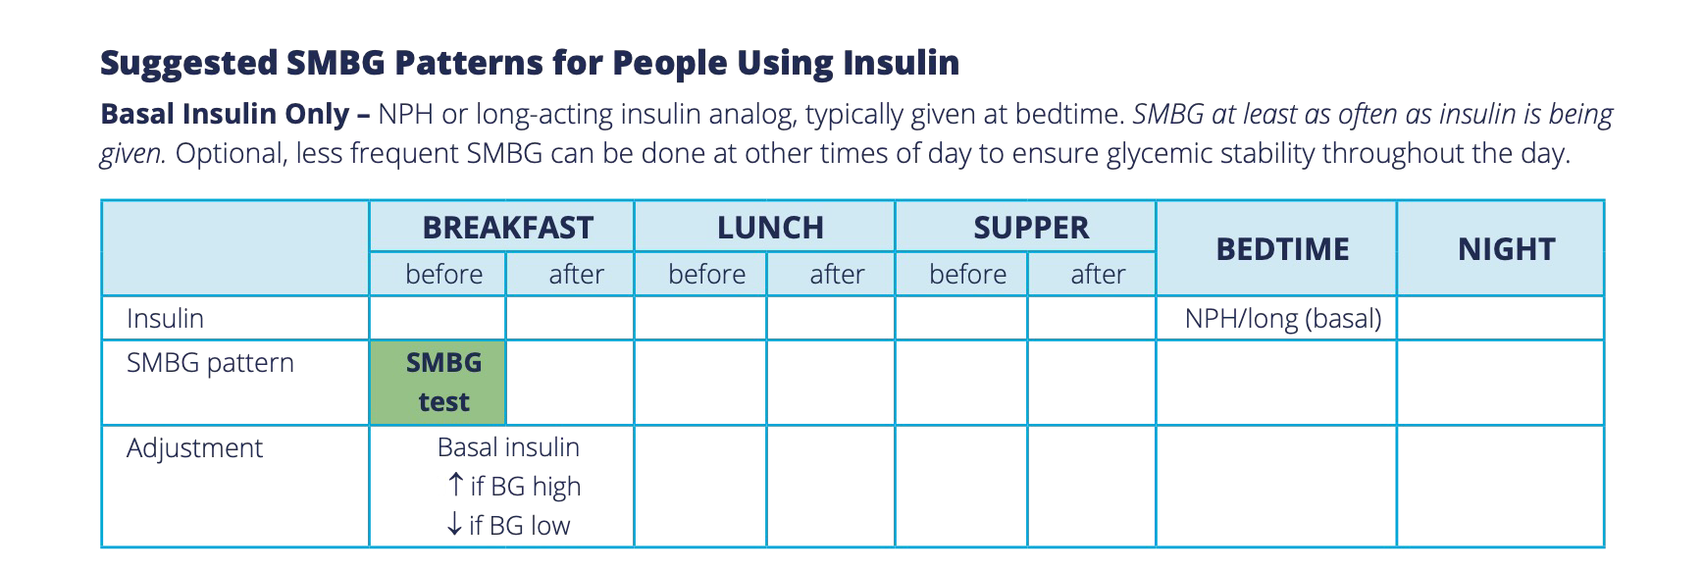


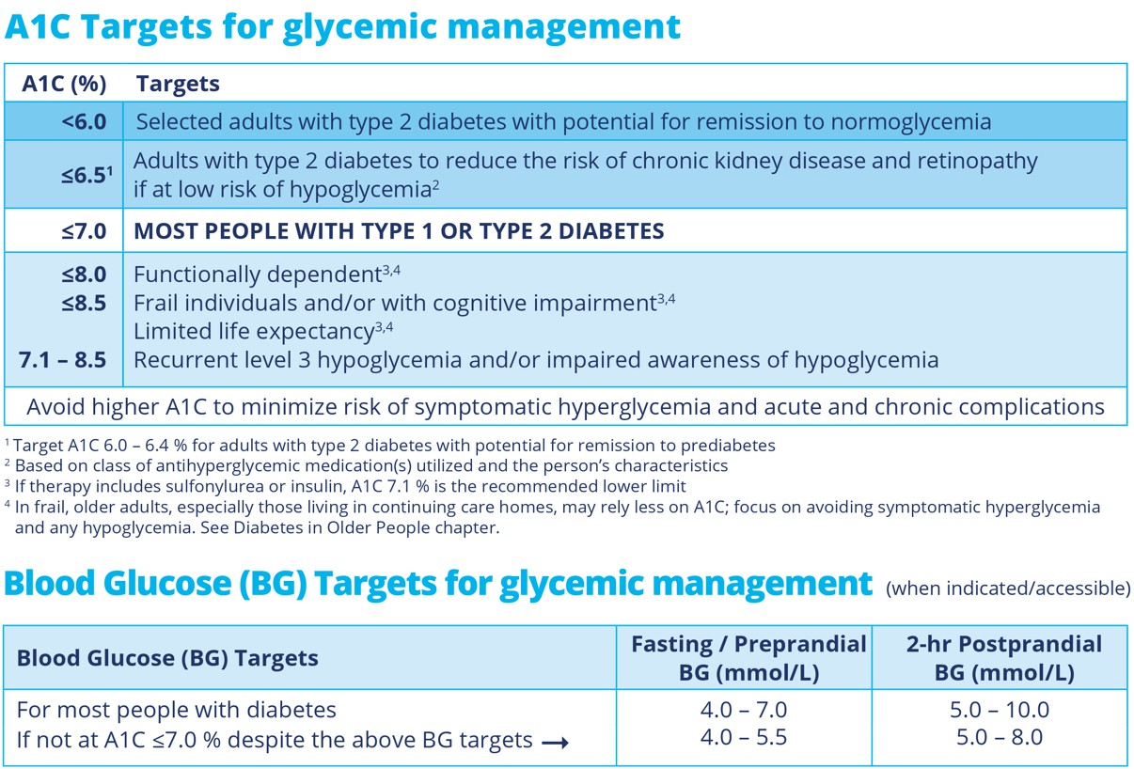

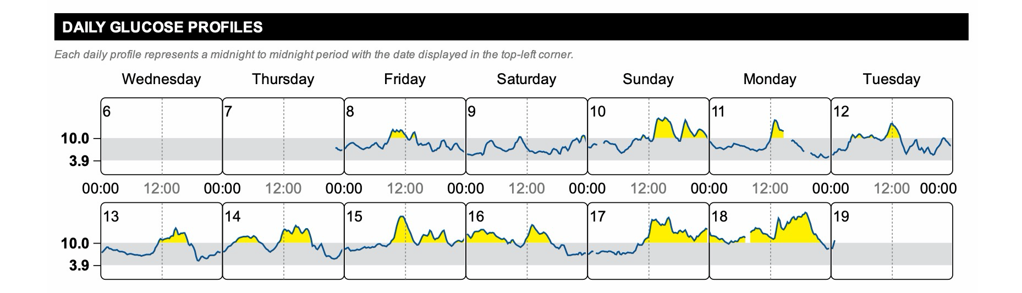
Insulin in Type 2 Diabetes
September 12, 2026
 | 34
GLUCOSE CHECKS: BLOOD GLUCOSE TARGETS FOR MOST PEOPLE WITH DIABETES
35

Slide 19

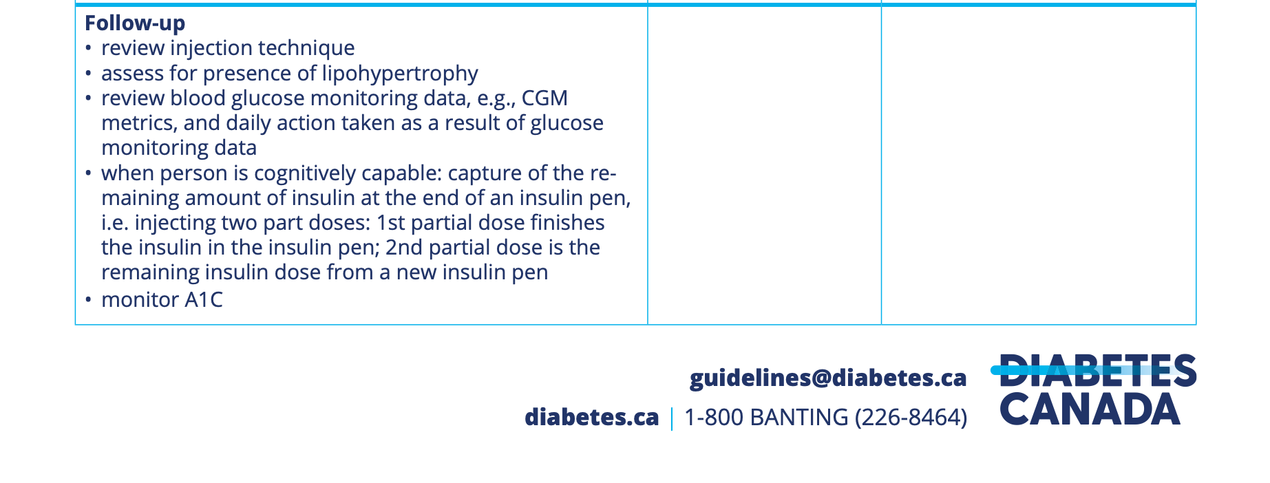
Insulin in Type 2 Diabetes
September 12, 2026
36
Starting insulin
Assessing insulin use
 | 37
ASSESSING EXISTING INSULIN SELF-MANAGEMENT IN A PERSON WITH TYPE 2 DIABETES

Slide 20
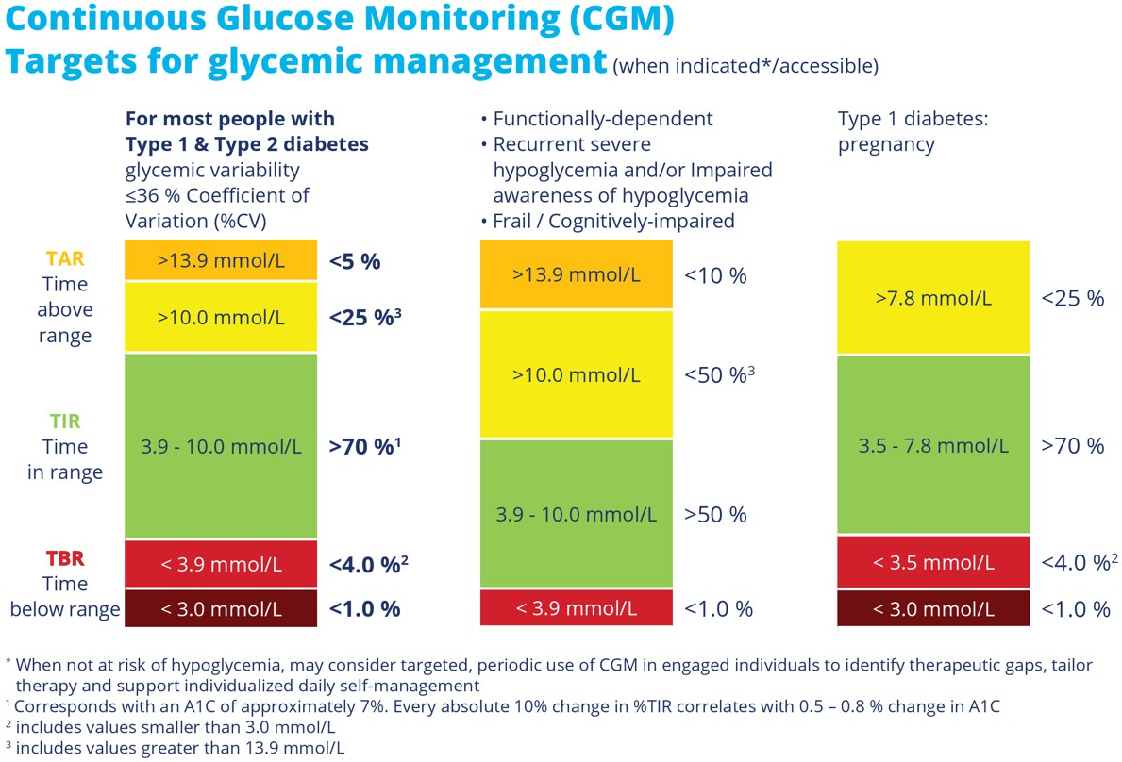
Insulin in Type 2 Diabetes
September 12, 2026
 | 38
REVIEW AND ASSESS BLOOD GLUCOSE DATA: CONTINUOUS GLUCOSE MONITORING TARGETS
 | 39
ACTING ON CONTINUOUS GLUCOSE MONITORING METRICS ASSESSMENT SHARED DECISION-MAKING

Slide 21
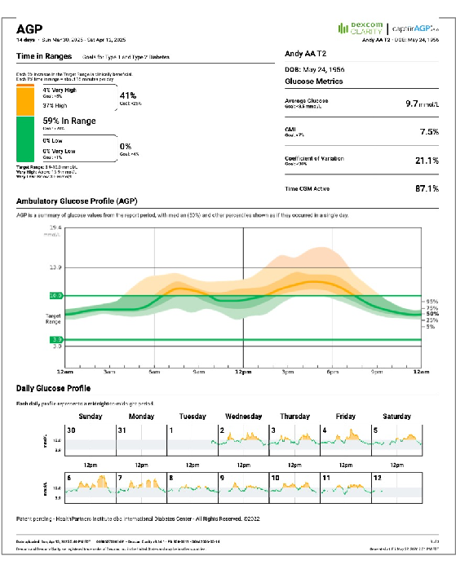

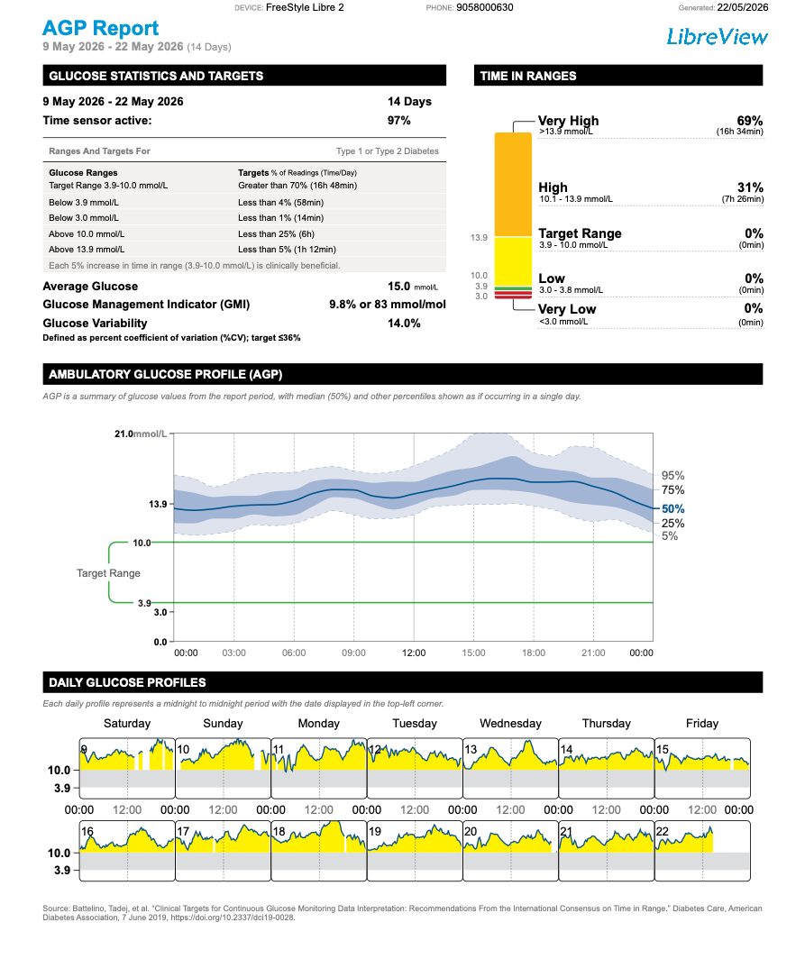
Insulin in Type 2 Diabetes
September 12, 2026
 | 40
Andy A., 70 year old, male Type 2 diabetes Obesity No other comorbidities Metformin 1,000mg p.o. twice daily Empagliflozin 10mg p.o. once daily Semaglutide 2.0mg s.c. once weekly Rosuvastatin 20mg p.o. once daily Perindopril 8mg p.o. once daily Shared Decision-making discussion could involve: Setting meaningful alerts / alarms Healthy eating Physical activity If not on insulin, consider start basal insulin If on basal insulin, uptitrate basal insulin
 | 41
Erica S., 45 year old, female Type 2 diabetes Obesity No other comorbidities Metformin 2,000mg ER p.o. once daily Empagliflozin 25mg p.o. once daily Tirzepatide 15mg s.c. once weekly Has refused statin therapy (at this time) Shared Decision-making discussion could involve: Setting meaningful alerts / alarms Healthy eating Physical activity If not on insulin, start basal insulin If on basal insulin Investigate fear of hypoglycemia Uptitrate basal insulin

Slide 22

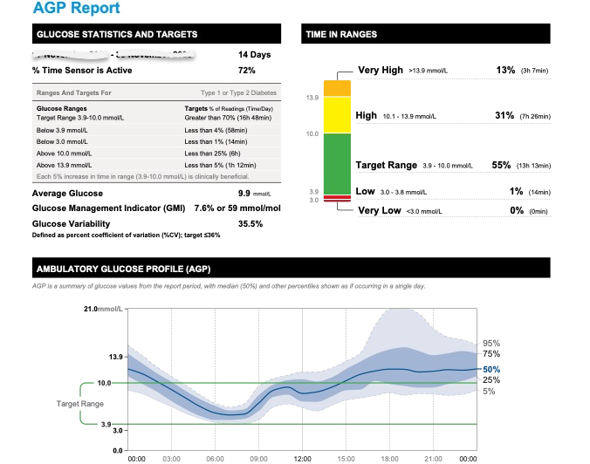
Insulin in Type 2 Diabetes
September 12, 2026
42
CONSIDERATIONS
Fear of hypoglycemia
Overbasalinization
Prednisone → NPH insulin
 | 43
REFERENCES Diabetes Canada. (2024). Insulin pen start checklist. Retrieved May 1, 2026, from https://guidelines.diabetes.ca/reduce-complications/insulin-checklist Diabetes Canada. (2025). Clinical Practice Guidelines. Retrieved May 1, 2026, from https://guidelines.diabetes.ca/cpgrefguide. Diabetes Canada. (nd). Insulin and you – A guide to injecting insulin. (video). Retrieved May 1, 2026, from https://www.youtube.com/watch?v=1lNGGBQqTLs. Ontario College of Family Physicians & The New Brunswick Diabetes Task Group. (2025). Insulin prescription tool for healthcare providers. Diabetes Canada. Retrieved May 1, 2026, from https://guidelines.diabetes.ca/reduce-complications/insulin-prescription-tool.

